Slide 1






NUMBER MAZE
CME1252 Project Based Learning II
Presented by: Cemil DALAR - 2019510025 Mustafa Efe DEMİR - 2020510026
21.05.2021 / Izmir

Slide 2



PRESENTATION OUTLINE
Introduction
Progress Summary
>> Requirements
>> Task Sharing
>> Scheduling
>> Completed Tasks
>> Incompleted Tasks: Reasons & Explanations
Problem Encountered
Algorithms & Solution Strategies
Screenshots
Conclusion
References

Slide 3



INTRODUCTION
Number Maze is a maze game inspired by Pacman.
The aim of the project is to develop a maze game in which the numbers are collected and the collected numbers are matched while the player moves in the maze and the highest score is tried to be reached.
. . . . . .

Slide 4
REQUIREMENTS
01
02
03
04
INTEGRATED DEVELOPMENT ENVIROMENT
JAVA KNOWLEDGE
TEAM SPIRIT
ENIGMA LIBRARY

Slide 5
TASK SHARING
Cemil DALAR | Mustafa Efe DEMİR
Gameboard | Player Movement
Timing | Backpack Implementation
Matching & Scoring | Collecting Number Rules
Input List | Random Moving Numbers
Random Moving Numbers | Game Over Rules
Path Finding | Path Finding
Test & Debugging | Test & Debugging

Slide 6
SCHEDULING
First Week | Second Week
Design of classes Menu and screen Load operations | Player movements Timing Backpack Implementation
Third Week | Fourth Week | Fifth Week
Input list Static numbers Random moving numbers Matching & Scoring | Path finding number movements Path finding algorithm | Debugging & Testing

Slide 7
COMPLETED TASKS
Menu and screen
Player movements
Timing
Backpack implementation
Input list
Static numbers
Random moving numbers
Matching & Scoring
Path finding number movements

Slide 8
INCOMPLETED TASK: REASONS & EXPLENATIONS
All tasks of the project given to us were completed completely and on time.

Slide 9
PROBLEMS ENCOUNTERED
Randomly moving numbers could be stuck.
Randomly moving numbers passing through the player.
Moving numbers left their mark behind.
Backpack implementation after matching.

Slide 10
ALGORITHMS & SOLUTION STRATEGIES
Randomly moving numbers keep moving in the same direction until they hit a wall or a number.
In the path finding algorithm, a priority variable was created by examining the coordinates of the player and the red numbers and tried to find short ways using this variable.

Slide 11
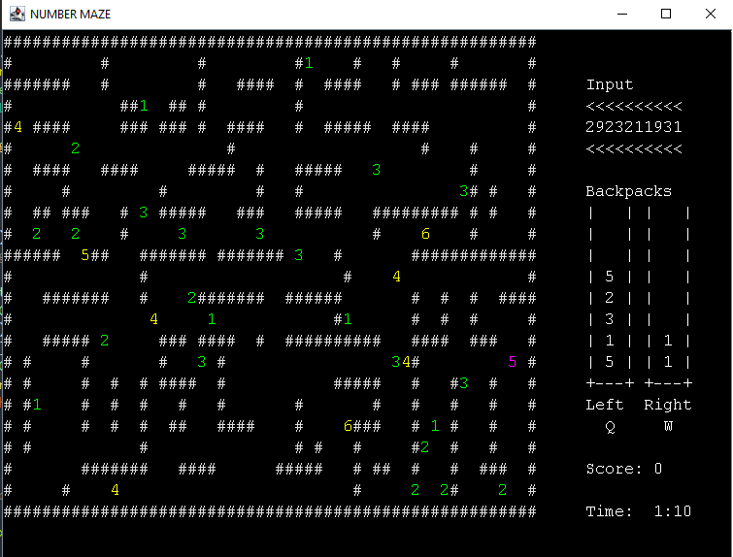
SCREENSHOTS

Slide 12
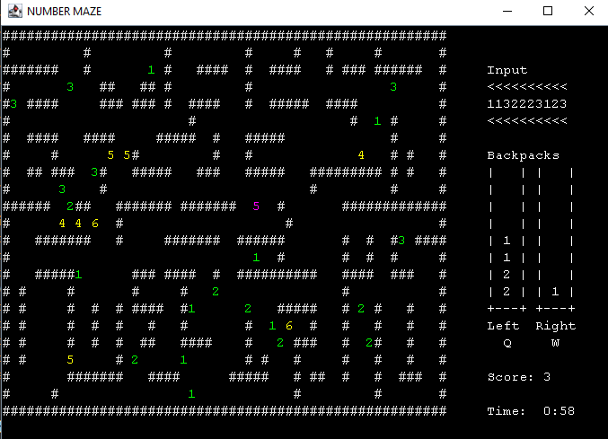

Slide 13
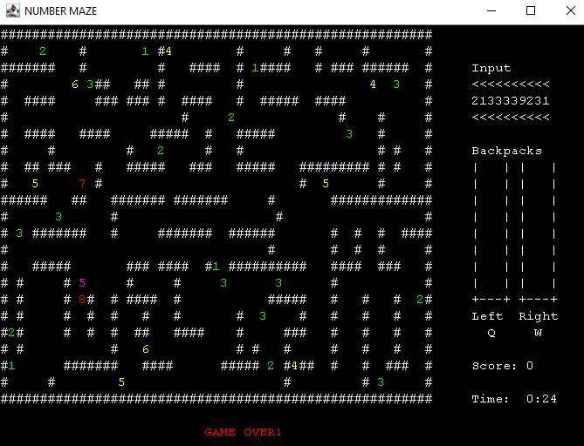

Slide 14
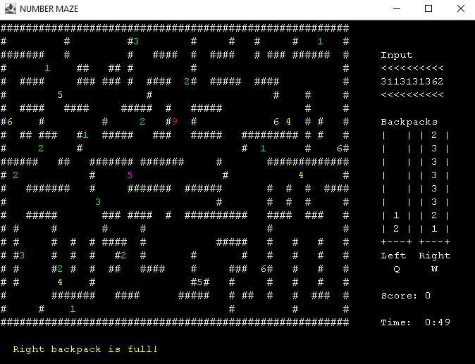

Slide 15
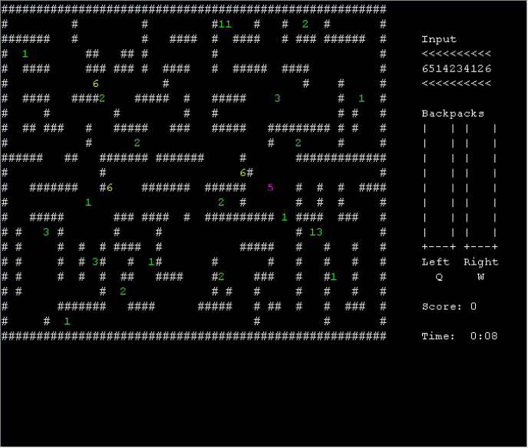
GAME DEMO

Slide 16
CONCLUSION
Task sharing
Take responsibility
Solving problems
Find and fix errors
Finding something new and using them
Completing project on time

Slide 17
REFERENCES
CME 1212 Algorithm and Programming Lectures
https://github.com/Sciumo/Enigma#:~:text=Enigma%20is%20a%20Java%2Dbased,any%20platform%2C%20with%20any%20program
(Enigma Library – Access Time: May 2021)
https://stackoverflow.com/questions/3664614/how-to-use-colours-in-console-output-in-scala-or-java/15168081
(Colored printing – Access Time: May 2021)

